Slide 1


Workflow Automation with
Generative AI
The Hong Kong Productivity Council (HKPC)
Jun 2025
Copyright @ 2025 HKPC All rights reserved

Slide 3
Workflow Automation with Generative AI
Fundamentals of Generative AI
Use cases in workflow automation
Hands-on with Workflow Automation Tool (n8n)

Slide 4
Fundamentals of Generative AI

Slide 6
Use cases in workflow automation

Slide 8
Hands-on with Workflow Automation Tool (n8n)

Slide 10
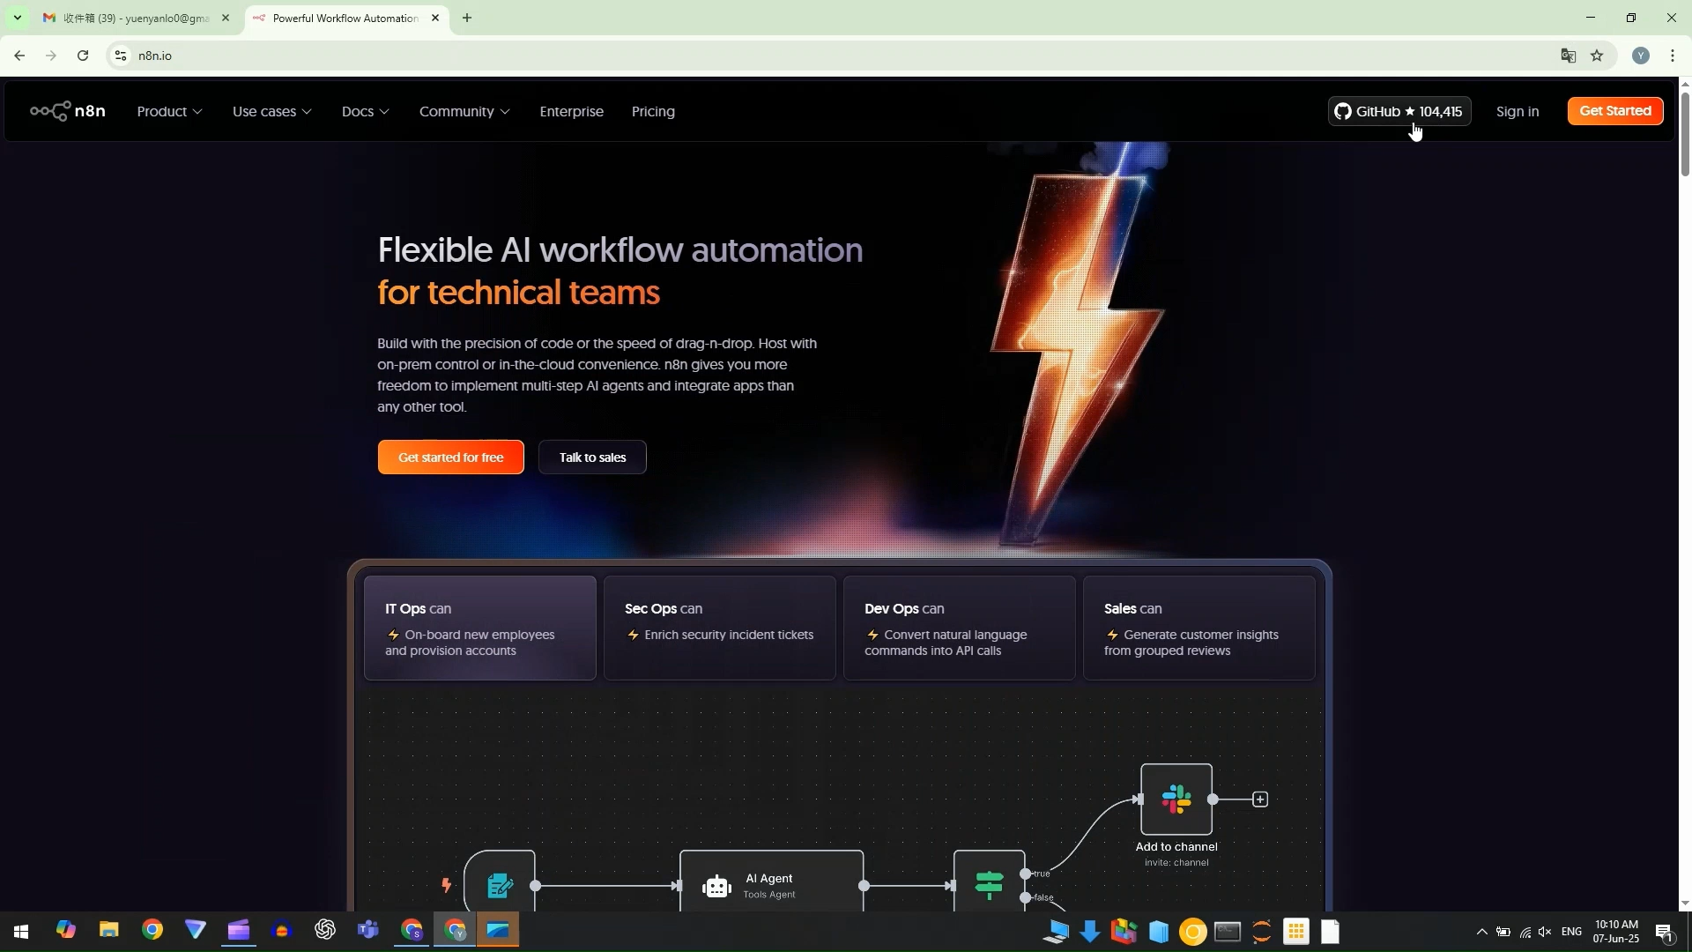
n8n Cloud Account Signup

Slide 11
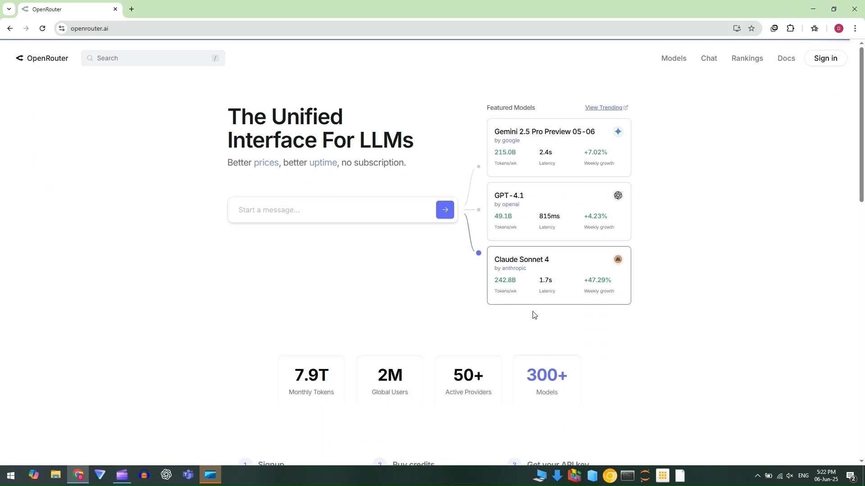
OpenRouter Account Signup

Slide 15










Your Trusted Partner
Hong Kong Productivity Council​
香港生產力促進局​
​
HKPC Building, 78 Tat Chee Avenue, Kowloon, Hong Kong​
香港九龍達之路78號生產力大樓​
Tel: +852 2788 5678 Whatsapp: +852 5283 4131​ www.hkpc.org

